Slide 1
Methods Presentation: Power Analysis for multiple regression with continuous response
Valentinas Sungaila

Slide 2
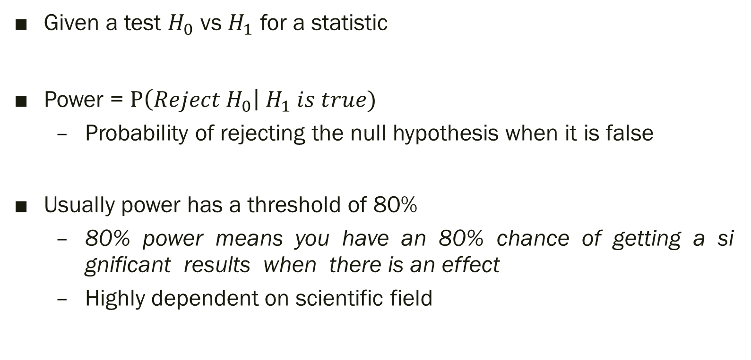
What is power?
Given a test $H_{0}$ vs $H_{1}$ for a statistic
Power = $P\left(Reject H_{0}\right| H_{1} is true)$
  Probability of rejecting the null hypothesis when it is false
Usually power has a threshold of 80%
  80% power means you have an 80% chance of getting a significant results when there is an effect
  Highly dependent on scientific field

Slide 3
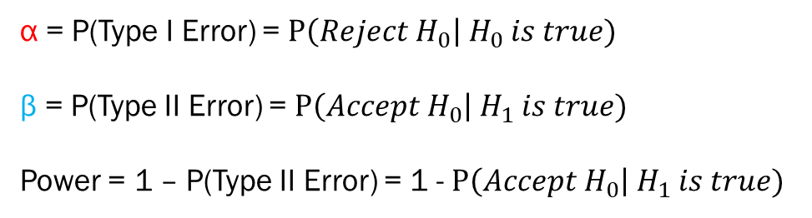
A Little Background
 | Null Hypothesis is True | Null Hypothesis is False
Accept Null Hypothesis | True Negative | False Negative
Reject Null Hypothesis | False Positive | True Positive
Note: Type I Error = False Positive, Type II Error = False Negative
α = P(Type I Error) = $P\left(Reject H_{0}\right| H_{0} is true)$
β = P(Type II Error) = $P\left(Accept H_{0}\right| H_{1} is true)$
Power = 1 – P(Type II Error) = 1 - $P\left(Accept H_{0}\right| H_{1} is true)$

Slide 4
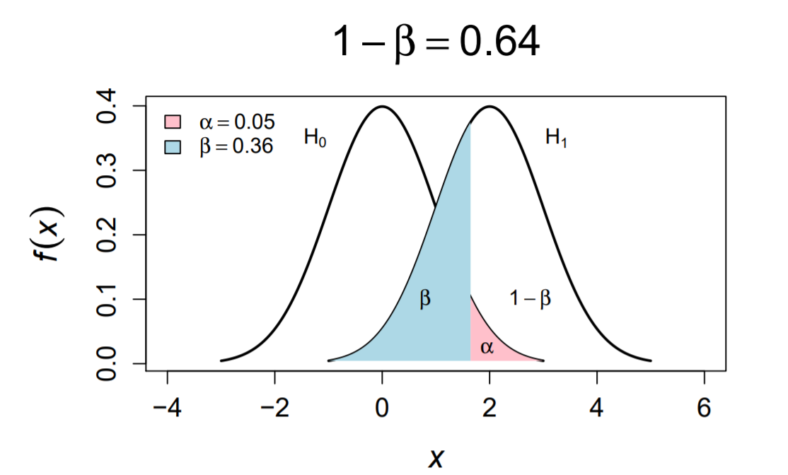
Visualizing Power
Source: Nathaniel E. Helwig (U of Minnesota)

Slide 5
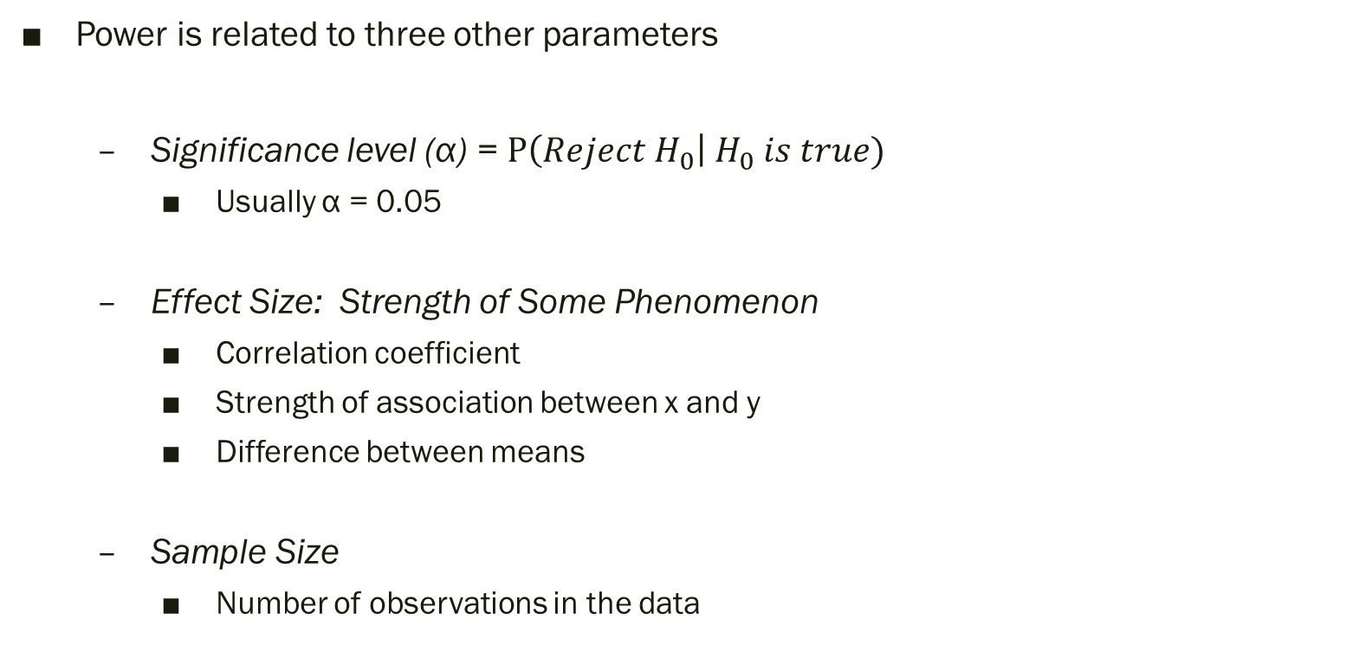
Things that Affect Power
Power is related to three other parameters
  Significance level (α) = $P\left(Reject H_{0}\right| H_{0} is true)$
    Usually α = 0.05
  Effect Size: Strength of Some Phenomenon
    Correlation coefficient
    Strength of association between x and y
    Difference between means
  Sample Size
    Number of observations in the data

Slide 6
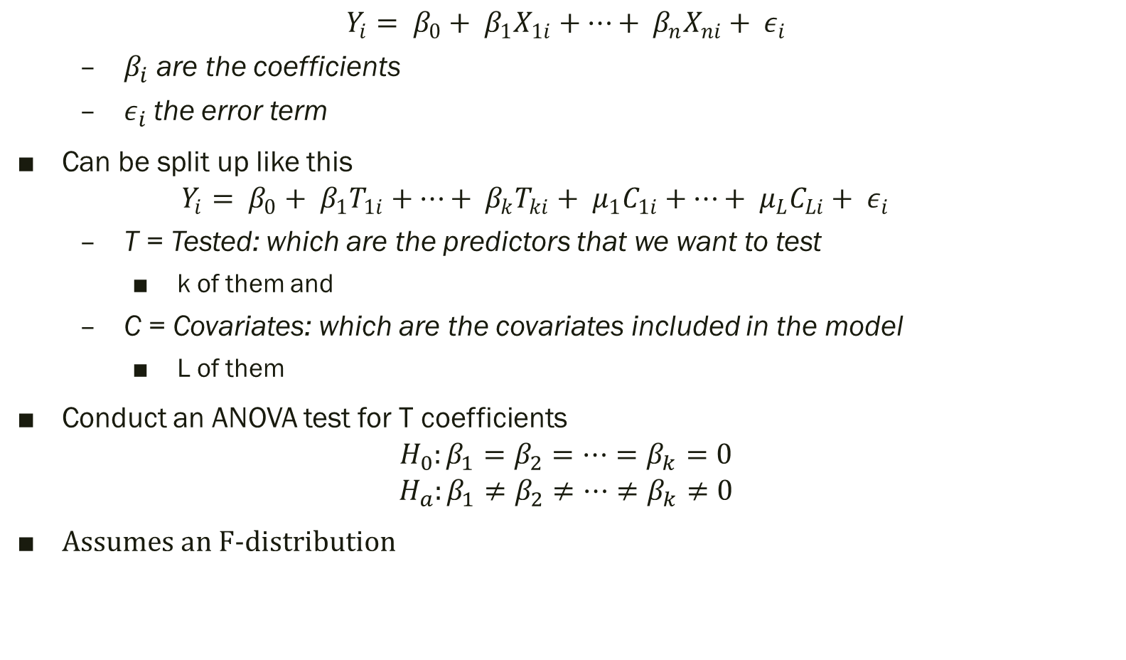
Multiple Regression
$$Y_{i}= β_{0}+ β_{1}X_{1i}+…+ β_{n}X_{ni}+ ε_{i}$$
  $β_{i}$ are the coefficients
  $ε_{i}$the error term
Can be split up like this
  $$Y_{i}= β_{0}+ β_{1}T_{1i}+…+ β_{k}T_{ki}+ μ_{1}C_{1i}+…+ μ_{L}C_{Li}+ ε_{i}$$
  T = Tested: which are the predictors that we want to test
    k of them and
  C = Covariates: which are the covariates included in the model
    L of them
Conduct an ANOVA test for T coefficients
$$H_{0}:β_{1}=β_{2}=…=β_{k}=0$$
$$H_{a}:β_{1}≠β_{2}≠…≠β_{k}≠0$$
Assumes an F-distribution

Slide 7
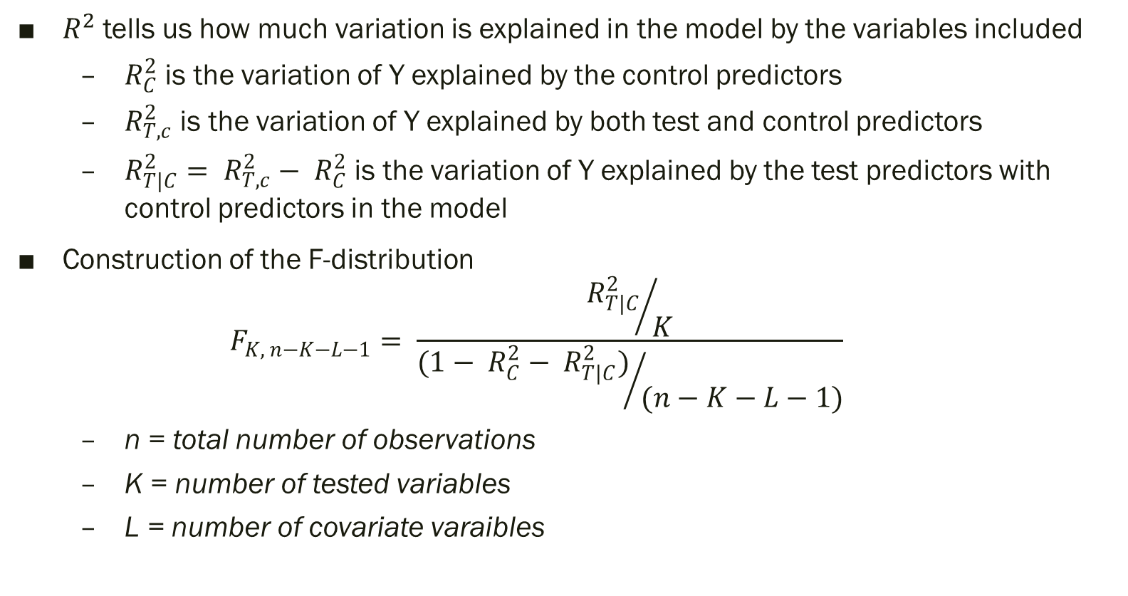
Constructing the F-distribution Using Variation Explained in the Model
$R^{2}$ tells us how much variation is explained in the model by the variables included
  $R_{C}^{2}$ is the variation of Y explained by the control predictors
  $R_{T,c}^{2}$ is the variation of Y explained by both test and control predictors
  $R_{T|C}^{2}= R_{T,c}^{2}− R_{C}^{2}$ is the variation of Y explained by the test predictors with control predictors in the model
Construction of the F-distribution
  $$F_{K, n−K−L−1}= \frac{{R_{T|C}^{2}}/K}{{(1− R_{C}^{2}− R_{T|C}^{2})}/{(n−K−L−1)}}$$
  n = total number of observations
  K = number of tested variables
  L = number of covariate varaibles

Slide 8
Central vs Non-Central Distributions
Central distribution describes how a test statistic is distributed when the difference tested is null
Non-central distributions describe the distribution of a test statistic when the null is false (so the alternative hypothesis is true)
Non-Centrality parameter λ can be calculated
  If λ = 0 then you have a central distribution
  If λ ≠ 0 then you have a non-central distribution

Slide 9
Source: Nathaniel E. Helwig (U of Minnesota)

Slide 10
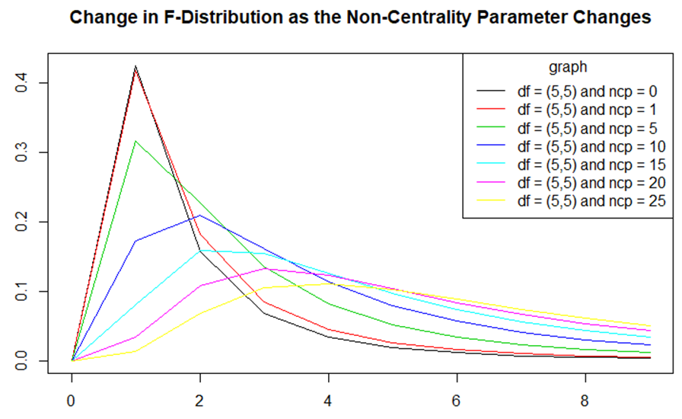
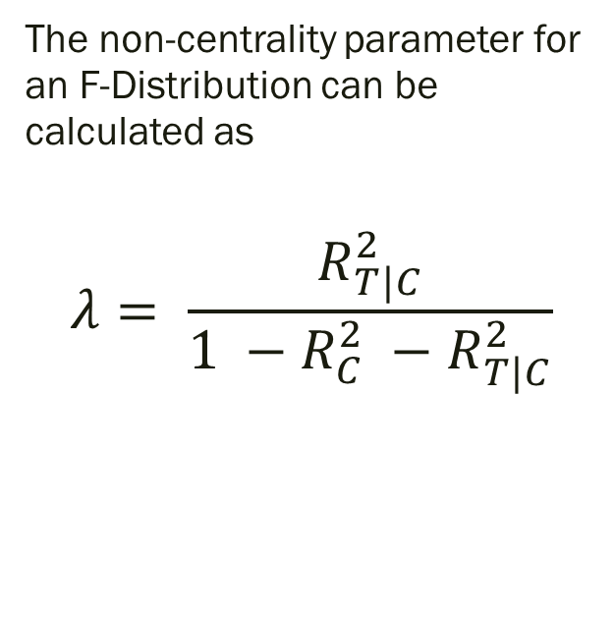
The non-centrality parameter for an F-Distribution can be calculated as
$$λ= \frac{R_{T|C}^{2}}{1 −R_{C}^{2} −R_{T|C}^{2}}$$

Slide 11
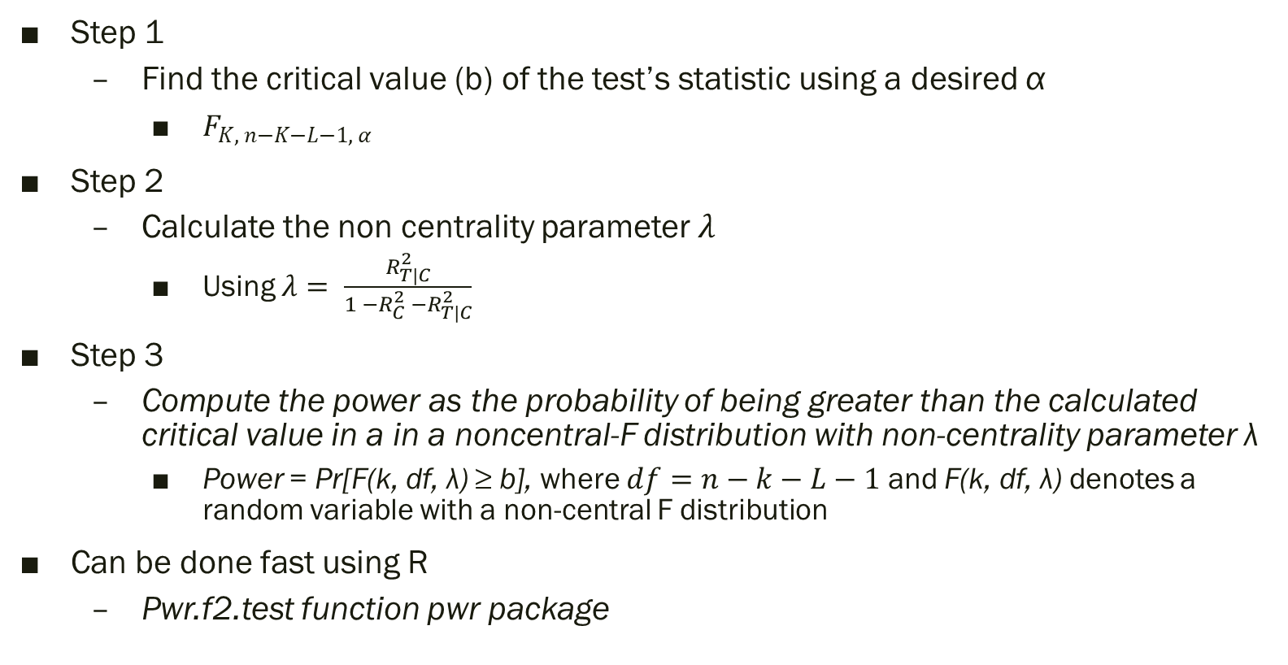
Calculating Power
Step 1
  Find the critical value (b) of the test’s statistic using a desired α
    $F_{K, n−K−L−1, α}$
Step 2
  Calculate the non centrality parameter $λ$
    Using $λ= \frac{R_{T|C}^{2}}{1 −R_{C}^{2} −R_{T|C}^{2}}$
Step 3
  Compute the power as the probability of being greater than the calculated critical value in a in a noncentral-F distribution with non-centrality parameter λ
    Power = Pr[F(k, df, λ) ≥ b], where $df=n−k−L−1$ and F(k, df, λ) denotes a random variable with a non-central F distribution
Can be done fast using R
  Pwr.f2.test function pwr package

Slide 12
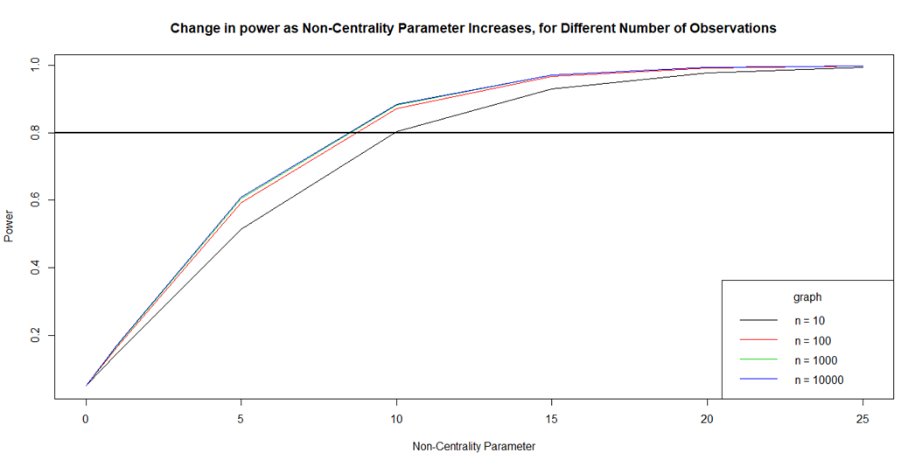
Changes in Power as Non-Centrality Parameter Changes

Slide 13
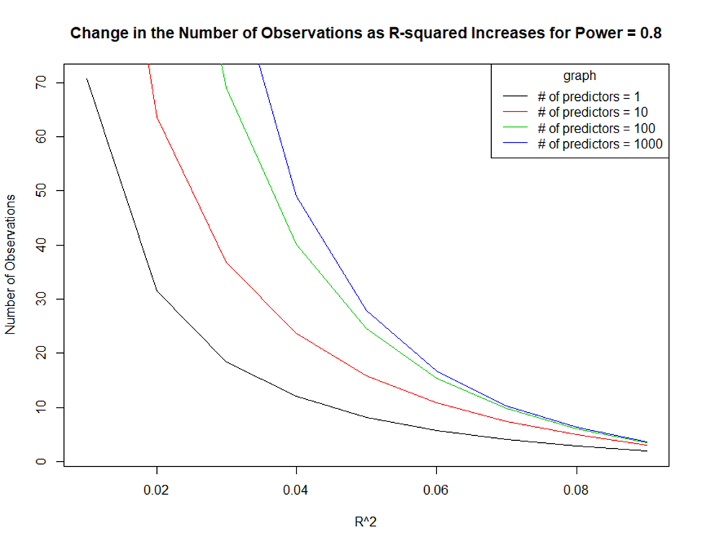

Changes in Power as $R^{2}$ Changes

Slide 14
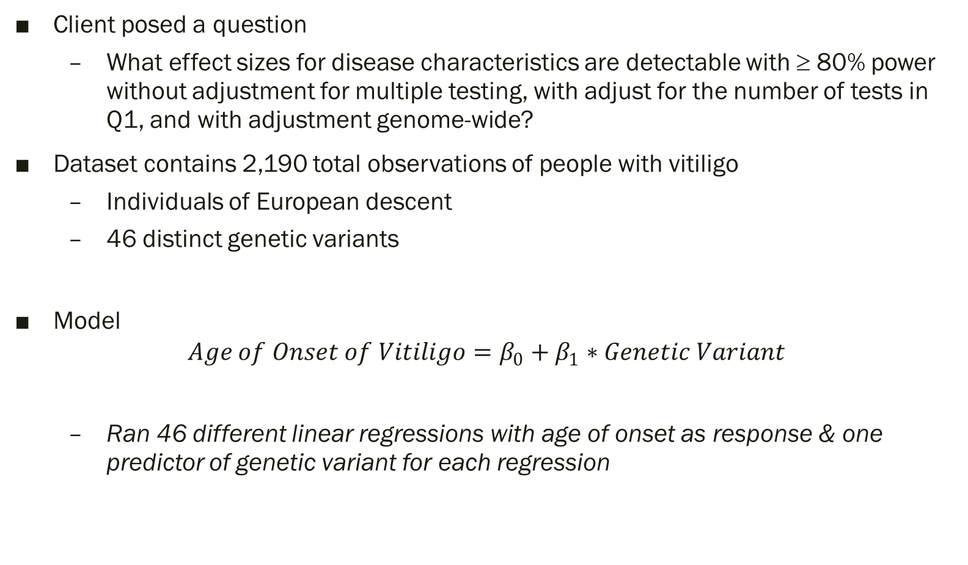
Case Study
Client posed a question
  What effect sizes for disease characteristics are detectable with ≥ 80% power without adjustment for multiple testing, with adjust for the number of tests in Q1, and with adjustment genome-wide?
Dataset contains 2,190 total observations of people with vitiligo
  Individuals of European descent
  46 distinct genetic variants
Model
$$Age of Onset of Vitiligo=β_{0}+β_{1}∗Genetic Variant$$
  Ran 46 different linear regressions with age of onset as response & one predictor of genetic variant for each regression

Slide 15
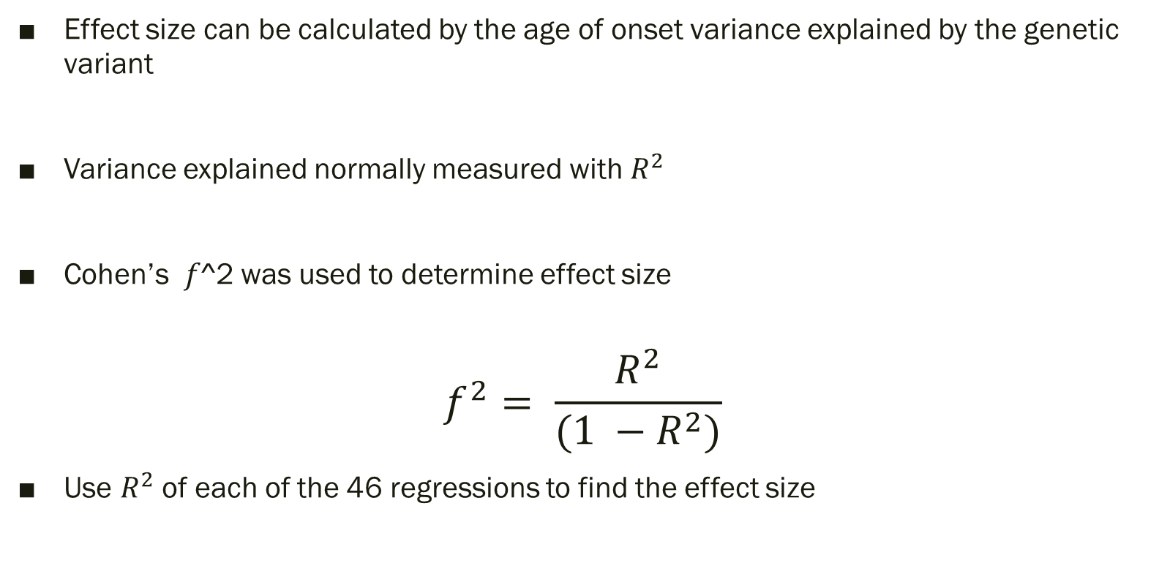
Calculating Effect Size
Effect size can be calculated by the age of onset variance explained by the genetic variant
Variance explained normally measured with $R^{2}$
Cohen’s 𝑓^2 was used to determine effect size
$$f^{2}= \frac{R^{2}}{(1 −R^{2})}$$
Use $R^{2}$ of each of the 46 regressions to find the effect size

Slide 16
Results
 | Inputs |  |  | Cohen's f^2 |  |  | R-squared Effect Size
 | Complete Observations | Power Desired | Effective DF | Unadjusted | Bonferroni Adjustment | Genome-wide adjustment | Unadjusted | Bonferroni Adjustment | Genome-wide adjustment
Age of Onset of Vitiligo | 2,190 | 80% | 1 | 0.0035889 | 0.00774619 | 0.01821105 | 0.0035761 | 0.00768665 | 0.01788534
Genetic variant RS114448410 is the only predictor that possesses a sufficiently high effect size to have at least 80% power
For unadjusted α = 0.05 and the Bonferroni adjusted α = 0.05/46
Effect disappears when genome-wide adjustment is used α = 5e-10

Slide 17
Thank you

